Slide 1

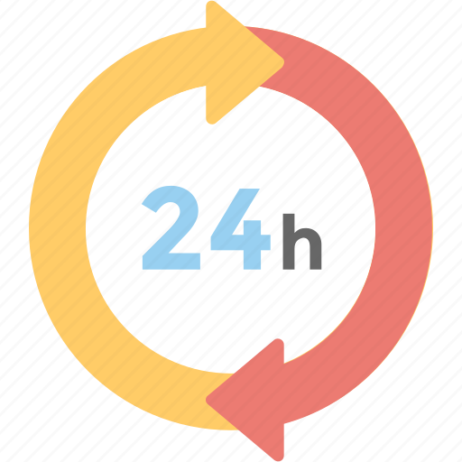
24-HOUR FORECAST
03-11-2022 @ 1200 UTC
Department of Meteorology and Climate Science,
KNUST.

Slide 2
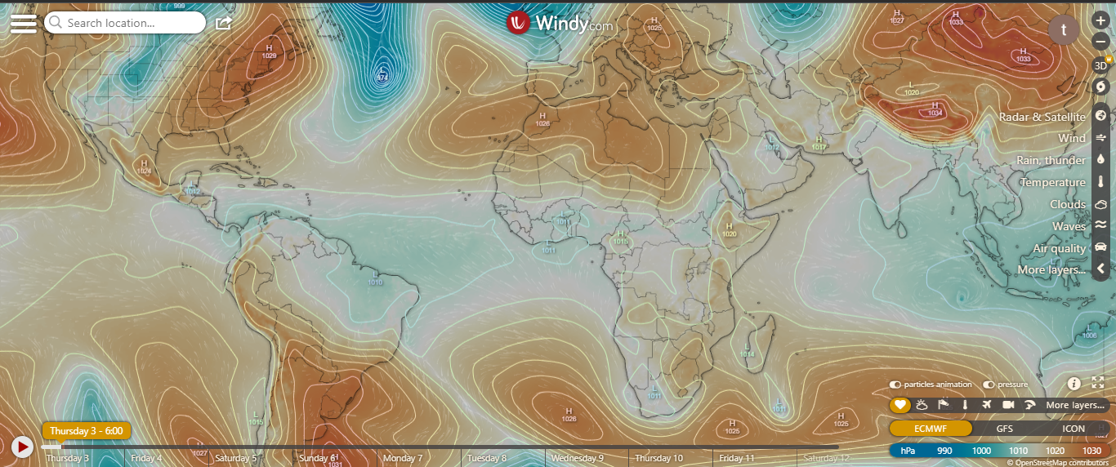
Presure System @ 0600 UTC
1028 hPa
1026hPa

Slide 3
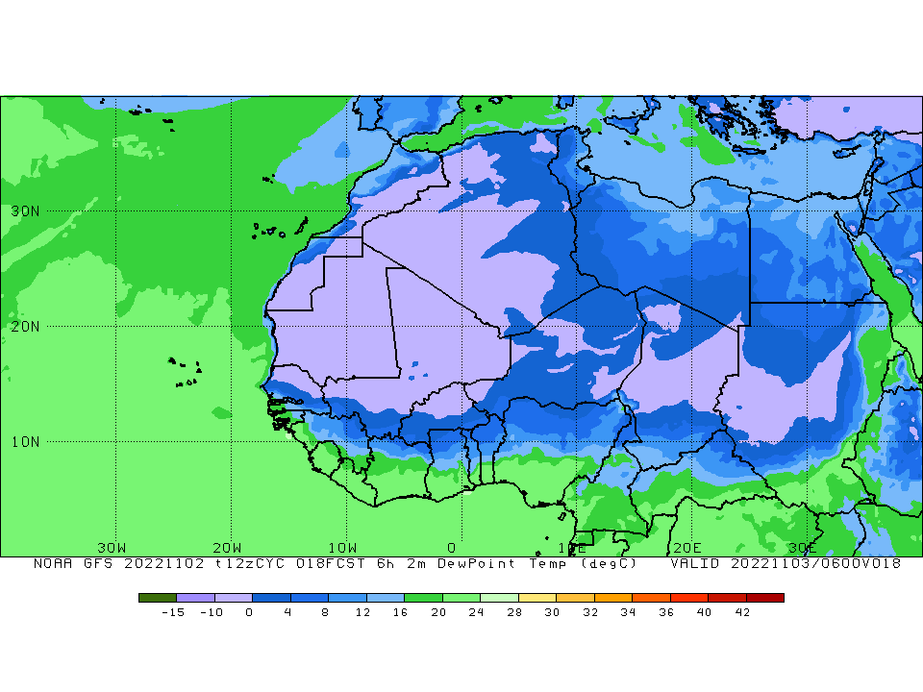
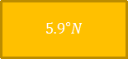
ITD POSITION @ 0600 UTC
ITD Position at 0600 UTC
$$5.9°N$$
℃

Slide 4
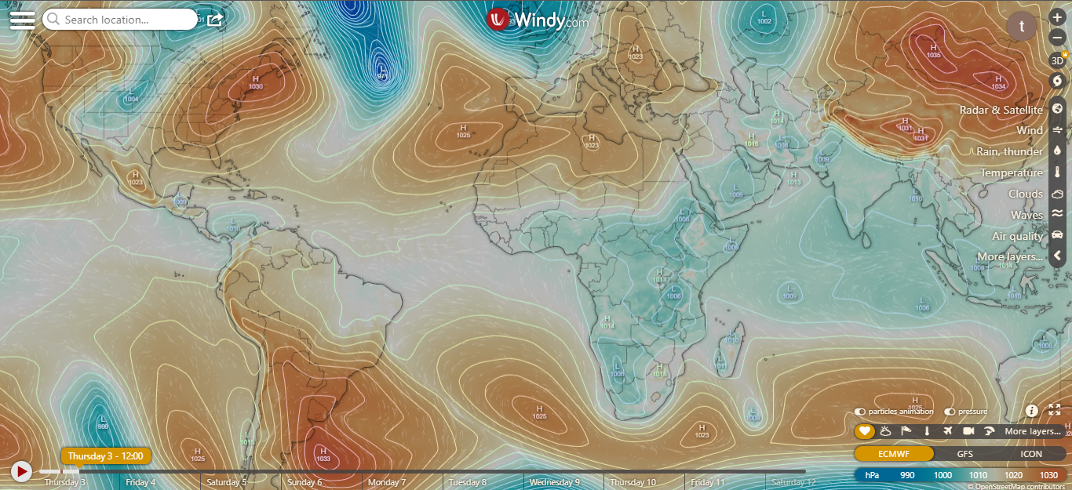
Presure System @ 1200 UTC
1026 hPa
1024 hPa

Slide 5
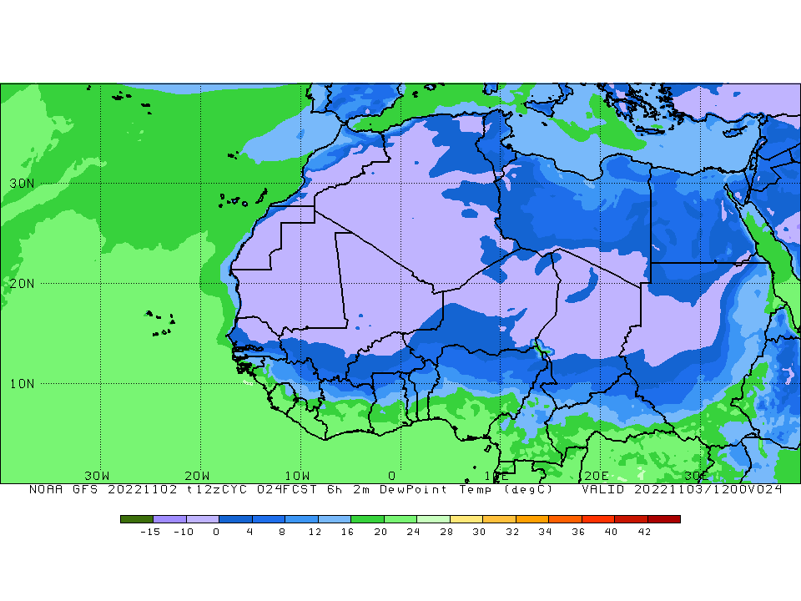
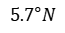
ITD POSITION @ 1200 UTC
ITD Position at 1200 UTC
$$5.7°N$$

Slide 6
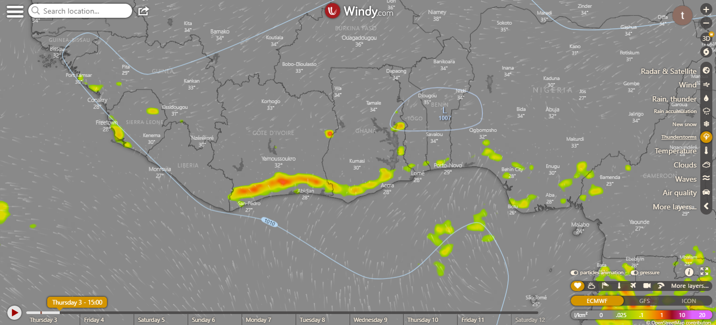
CONVECTIVE CELLS@ 1500 UTC

Slide 7
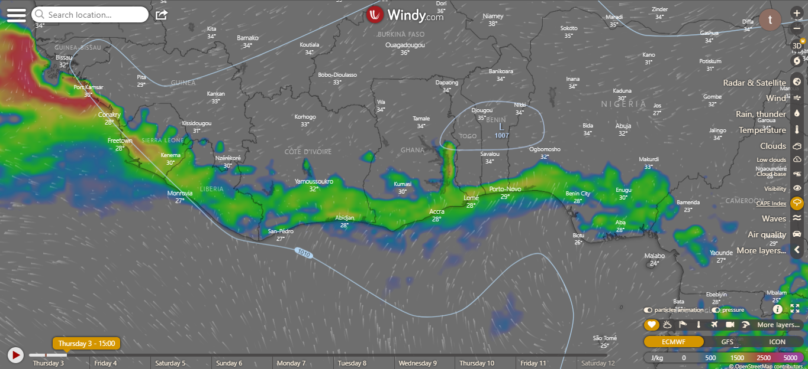
CAPE @ 1500 UTC

Slide 8
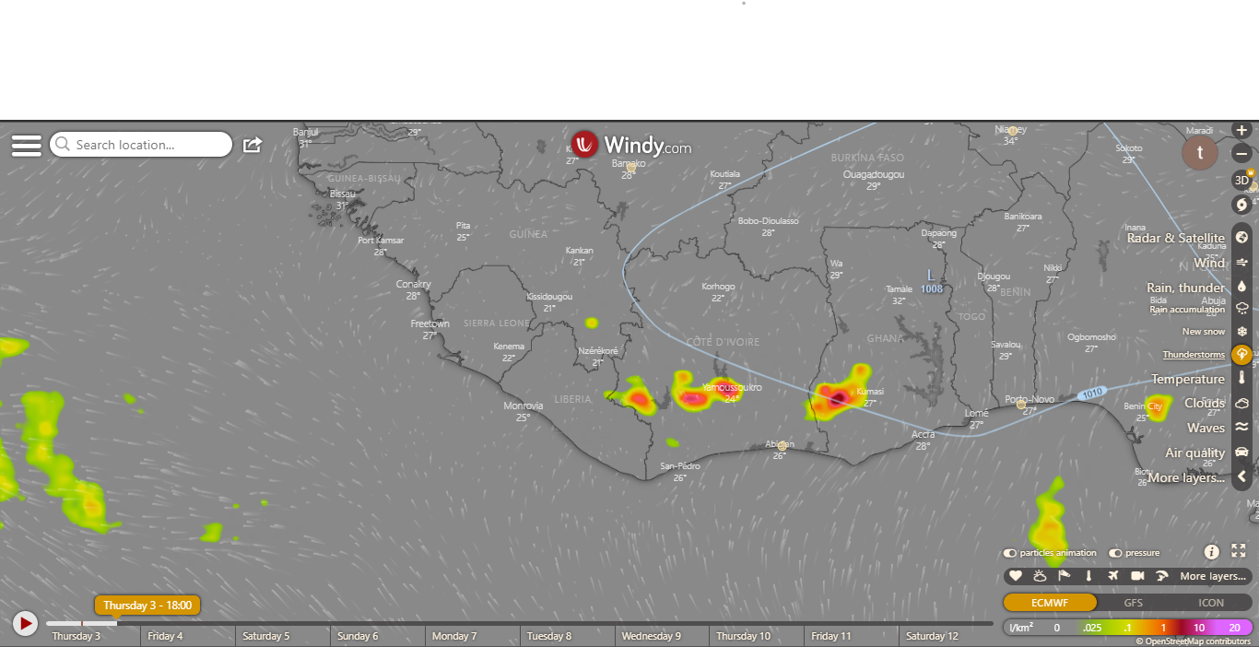
CONVECTIVE CELLS@ 1800 UTC

Slide 9
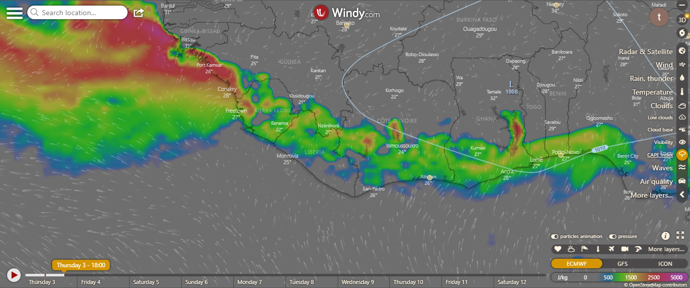
CAPE @ 1800 UTC

Slide 10
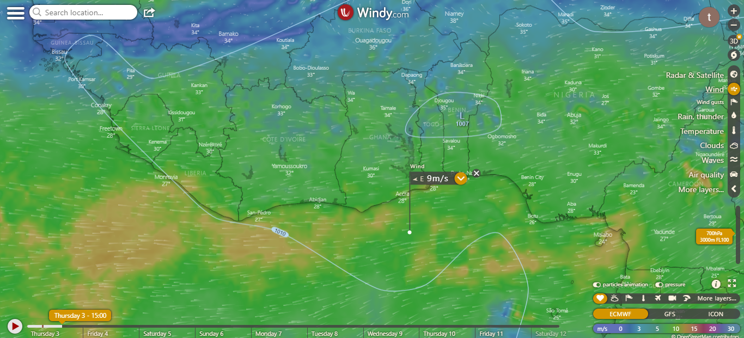
AEJ @ 1500 UTC

Slide 11
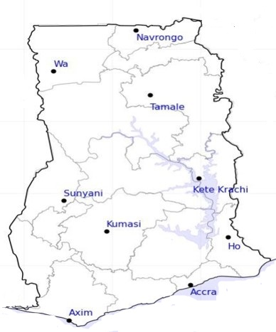
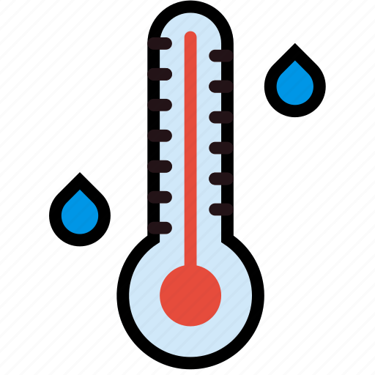
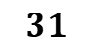
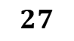
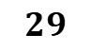
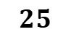
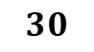
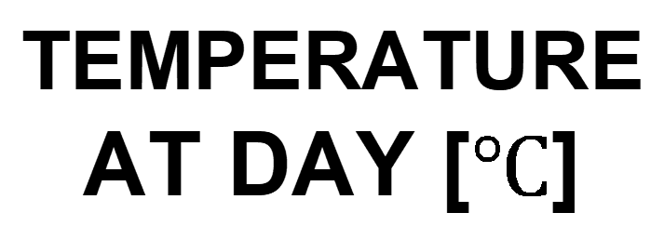
$$31$$
24-HOUR FORECAST
03-11-2022 @ 1200 UTC
32
TEMPERATURE AT DAY [$℃$]
31
33
Damango
31
$$30$$
$$30$$
$$25$$
$$29$$
$$27$$

Slide 12
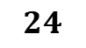
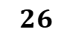
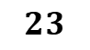
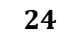
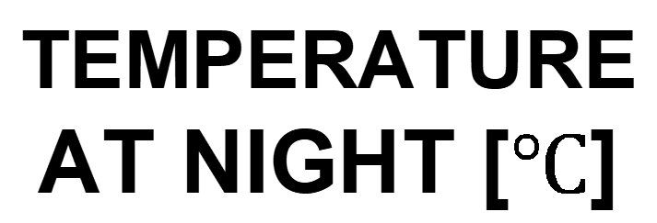
$$23$$
24-HOUR FORECAST
03-11-2022 @ 1200 UTC
$$24$$
TEMPERATURE AT NIGHT [$℃$]
$$25$$
$$24$$
Damango
$$27$$
23
$$24$$
$$23$$
$$26$$
$$25$$

Slide 13

24-HOUR FORECAST
03-11-2022 @ 1200 UTC
30
29
RH AT DAY
[%]
47
38
Damango
69
66
64
81
77
80

Slide 14
52
24-HOUR FORECAST
03-11-2022 @ 1200 UTC
56
RH AT NIGHT
[%]
70
74
Damango
76
92
95
98
92
89

Slide 15
0
24-HOUR FORECAST
03-11-2022 @ 1800 UTC
0
CAPE AT 1800
0
0
Damango
639
510
J/kg
1177
898
1040
318

Slide 16



NERAL OUTLOOK
24-HOUR FORECAST
03-11-2022 @ 1200 UTC
Rain
Wind
Dust
PROBABILITY OF RAINS
10-35%
Low risk
Be aware
Be Prepared
Take Action

Slide 17
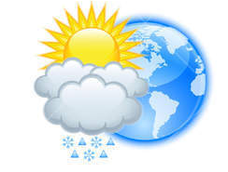



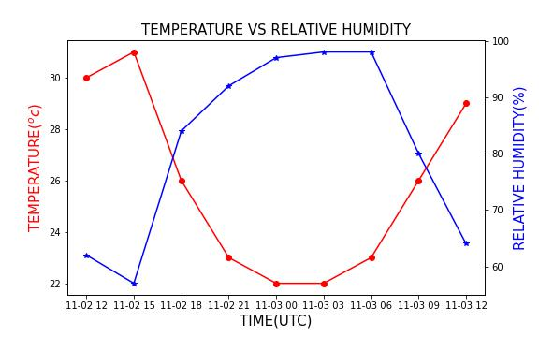

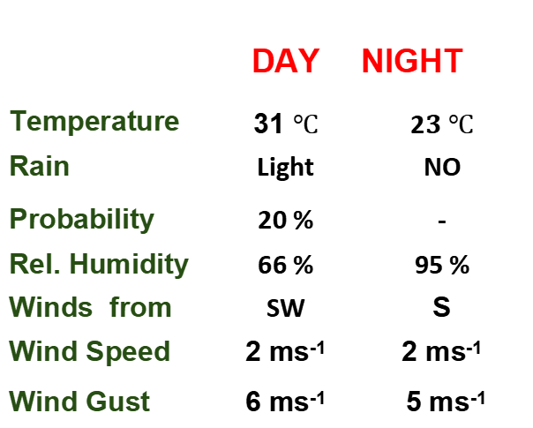
Meteorology and Climate Science
Department of Meteorology and Climate Science , KNUST
24-HOUR FORECAST
03-11-2022 @ 1200 UTC
Rain
Wind
Dust
Forecast Summary (KUMASI)
 | DAY | NIGHT
Temperature | 31 $℃$ | 2$3 ℃$
Rain | Light | NO
Probability | 20 % | -
Rel. Humidity | 66 % | 95 %
Winds from | SW | S
Wind Speed | 2 ms⁻¹ | 2 ms⁻¹
Wind Gust | 6 ms⁻¹ | 5 ms⁻¹
Low risk
Be aware
Be Prepared
Take Action
SUNSET: 05:47 PM SUNRISE: 05:55 AM

Slide 18


